Slide 1
HONEY Project
Taylor, Rusul, Richard, Rebecca

Slide 2

What is Food and what does it do?

Slide 3
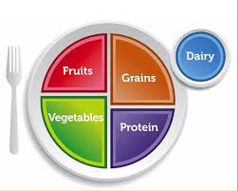
MY PLATE

Slide 4
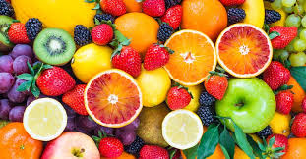
Fruit
Fresh, canned, frozen, dried, pureed and/or 100% fruit juice
Examples
  Bananas, apples. Strawberries, oranges
Fruits have many nutrients
  Potassium, fiber, vitamin C
These things keep us healthy and protect us against disease!

Slide 5
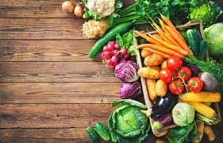
Vegetables
Vegetables may be raw or cooked; fresh, frozen, canned, or dried/dehydrated; and may be whole, cut-up, or mashed or 100% vegetable juice.
Examples
  Broccoli, carrots, cucumber, lettuce
Nutrients
  Potassium, dietary fiber, folate (folic acid), vitamin A, and vitamin C
They help you grow, boost your immune system, and help you fight off disease!

Slide 6
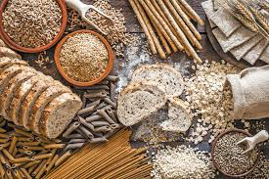
grains
Foods made from wheat, rice, oats, cornmeal, barely, or other cereals.
Examples
  Pasta, bread, rice, cereal, oatmeal, tortillas
Whole Vs. Refined
  Whole - has dietary fiber, B-vitamins, antioxidants
    Ex - brown rice, oatmeal
  Refined - processed, vitamins are added back in, but dietary fiber is not.
    Ex - white rice, white bread
Grains fuel us with energy, make us feel good, and help us digest all the other foods on our plate!

Slide 7
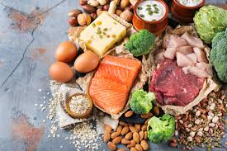
Protein foods
Not just meat!
Protein group includes foods made from
  Meat, poultry, seafood, beans, peas, eggs, soy products, nuts, and seeds.
B-vitamins, iron, zinc
It helps your muscles, gives you energy, and even makes the hormones in your body!

Slide 8
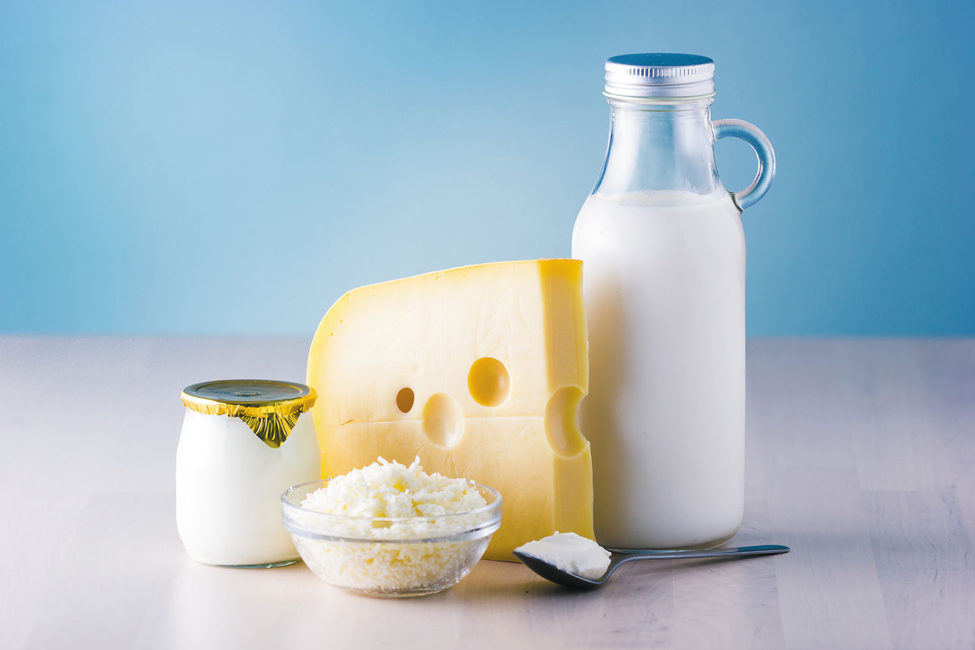
Dairy
Milk or certain products that are made from milk
Examples
  Milk, yogurt
Keeps our bones and teeth strong!
Calcium, potassium, vitamin D

Slide 9
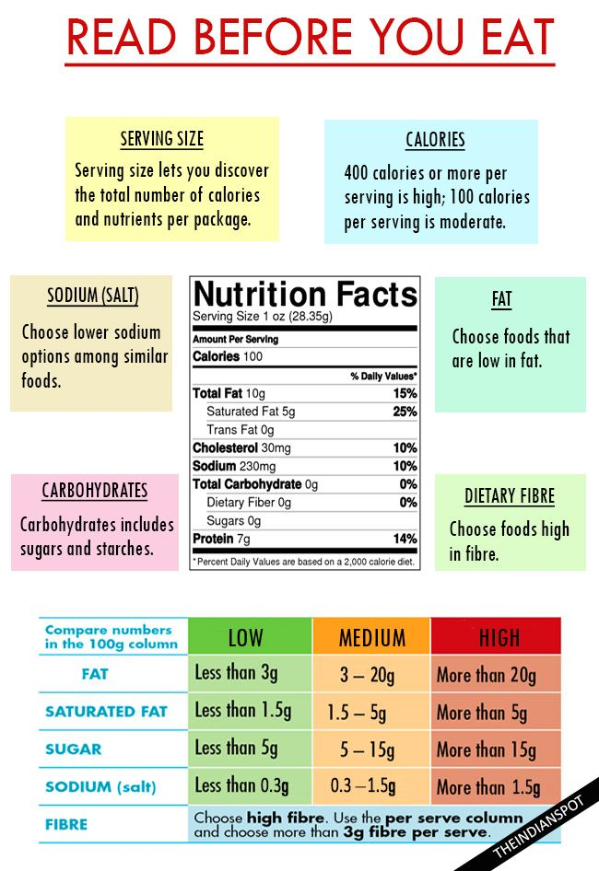
Nutrition Labels
What is Nutrition label :
Tells you how many nutrients are in that amount of food, and always lists a serving size, which is an amount of food
Serving sizes also help people understand how much they're eating.
What We need to look at when We read the Nutrition label:
Serving Size
Calories
Nutrients
The percent Daily Values

Slide 10

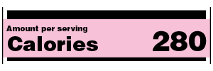
Nutrition Labels: Contents
1) Serving size:
Look at this first
Used in familiar units to make it easy to compare similar foods
Reflect the amount that people typically eat or drink
But, It is not a recommenation of how much you should eat or drink
All the nutrients amounts shown on the label, including the number of calories, refer to the size of the serving
2) Calories
Provides a measure of how much energy you get from a serving of the food.
For a healthy body weight, balance the number of calories you eat and drink with the number of calories that your body uses. Usually 2,000 calories a day is used as the guide for nutrition advice.
Your calorie needs might vary depending with your age, sex, height, weight, and physical activity.

Slide 11
Nutrition Labels: Contents
3) Nutrients
Depicts some of the key nutrients that impact your health
Use it to support your personal dietary needs by looking at foods that contain more of the nutrients that you are looking for
Nutrients to get less of: saturated fat, sodium, and added sugars.
Nutrients to get more of: Dietary fiber, Vitamin D, Calcium, Iron, and Potassium
4) Percent Daily Value (%DV)
It shows the percent daily value for each nutrients is a serving of the food
Daily values are reference amounts of nutrients to consume or not to exceed each day.
Shows how much of the nutrient in a serving contributes to a total daily diet
Helps in determining if a serving of food is high or low in a nutrient.

Slide 12
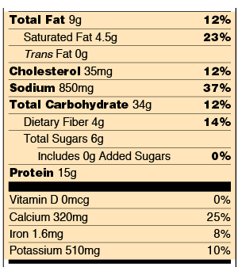
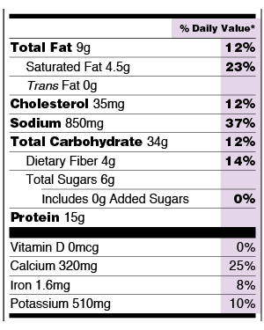
Nutrition Labels: Contents
3) Nutrients
4) Percent Daily Value

Slide 13
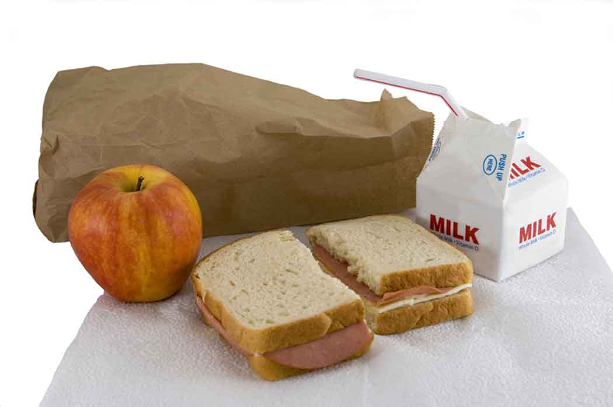
Typical Lunch
Sandwiches
  White bread, lunch meat, cheese slices, peanut butter, jelly
Chips
  High calories, high sodium, high carb
Cookies
  High calorie, high carb, high added sugar
Lunchables
  Ultra processed
Juices/sodas
  High sugar
Cup o’ Noodles
  High sodium, ultra processed

Slide 14
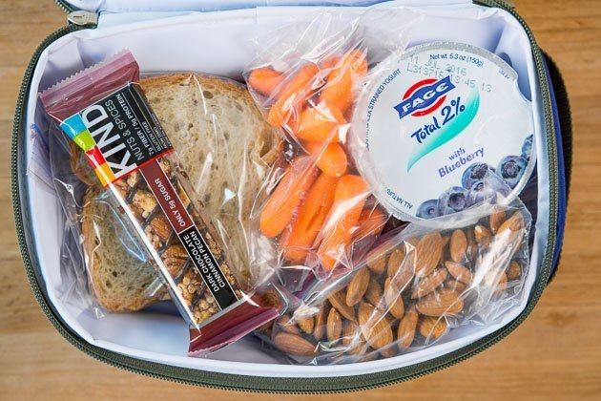
Healthy Lunches
How can we make our lunches healthier?
Add fruits and vegetables
  Apple slices, carrot sticks, celery, berries
You can keep chips, but add healthier options
  Sun chips (whole grains),
PB&J’S are a great source of protein!
  Sub wheat bread for white bread
Lunch meat sandwiches are good too
  Wheat bread, real cheese slices

Slide 15
Conclusion
Food – What gives the body energy it requires to function normally
A standard meal should include: fruits, vegetables, grains, proteins, and dairy products in varying proportions.
All these key food types provide essential nutrients required by the body such as Vitamins and Minerals.
The proportions of these nutrients can be deduced by simply looking at nutrition labels.
Nutrition Labels - tells you how many nutrients are in that amount of food

Slide 16
Conclusion
What to look at when reading nutrition labels:
1) Serving Size - Reflect the amount that people typically eat or drink
2) Calories - Provides a measure of how much energy you get from a serving of the food
3) Nutrients - Use it to support your personal dietary needs by looking at foods that contain more of the nutrients that you are looking for
4) Percent Daily Value - Shows how much of the nutrient in a serving contributes to a total daily diet
For a healthy diet:
Nutrients to get less of: saturated fat, sodium, and added sugars.
Nutrients to get more of: Dietary fiber, Vitamin D, Calcium, Iron, and Potassium

